Slide 1

P2P Lending and Loan Defaults
Team 9: Sharat Chandra Vupparaboina
(A549F327)
Krishna Reddy Patlolla
(A637C336)
Yogananda Theeguru (Q584C295)

Slide 2
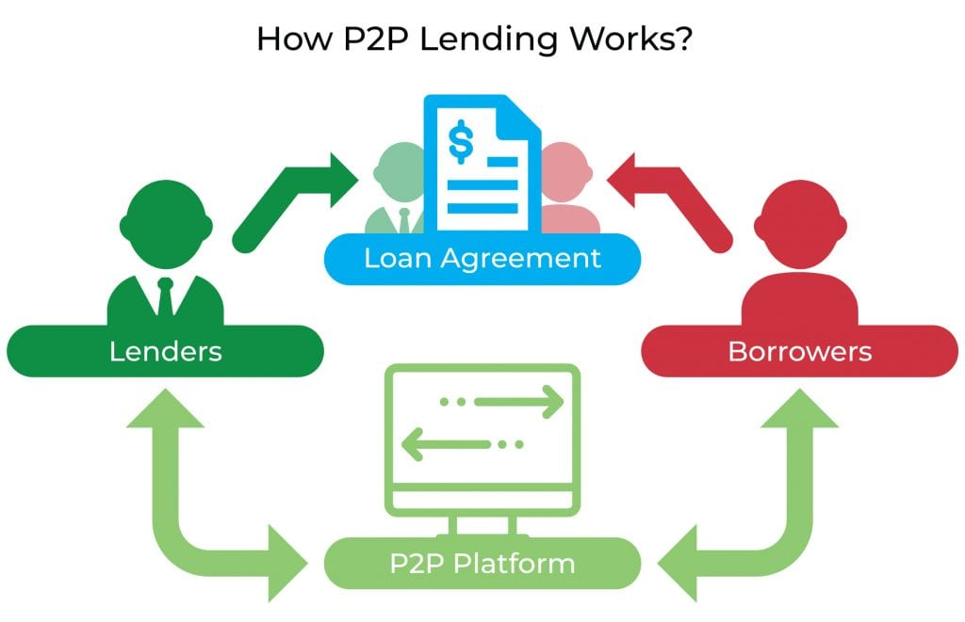
Introduction
P2P Lending is an online platform system for lending loans to prospective borrowers.
An alternative to typical banking and financial institutions.
Customers can register themselves on the platform either as a Lender or Borrower.

Slide 3
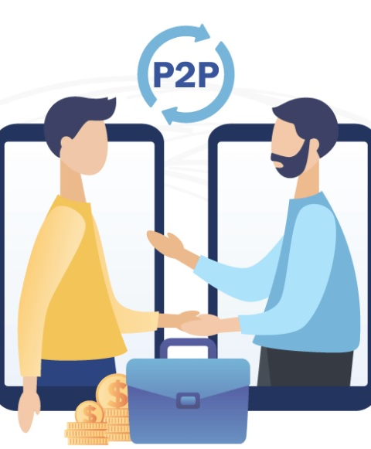
Bank Vs P2P
Visit the Bank
Wait for your turn
Speak to an employee
Apply for the loan
Gather all documents and submit
Banks verification
Loan Decision
Create Account Online
Post Requirement of Loan
Connect with lenders
Choose from multiple lenders with different interest rates
Platform runs online verification
Get Loan decision within minutes
Bank P2P

Slide 4
Hypothesis
Predicting if a customer is risky or not so that the lenders can take an informed decision whether to approve the loan or not, resulting in the trust on the platform.
This will directly result in sustainable revenue model as the customers do not leave the platform for a better one.

Slide 5
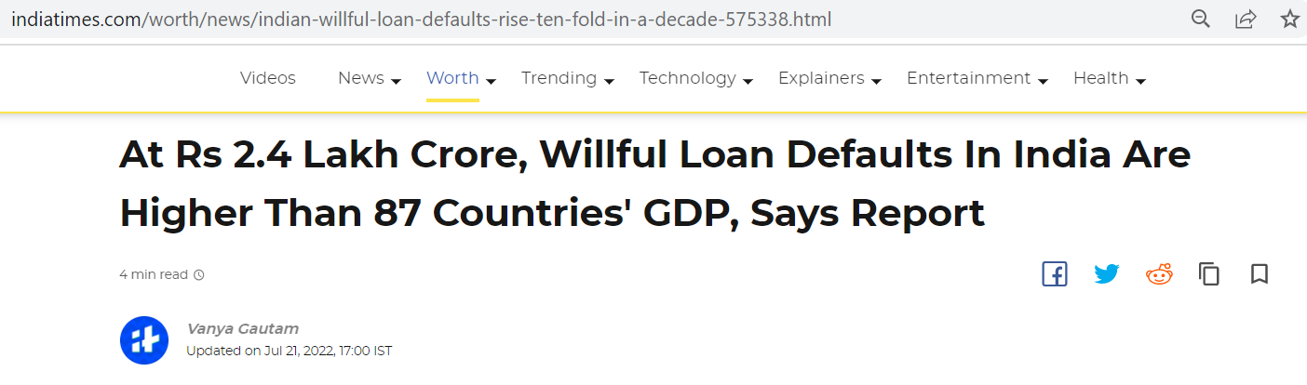
The Problem: Loan Default
Actual total Loan defaults could be at least 3 times more than this at approximately $10 Billion USD or INR 8.1 Lakh Crore.

Slide 6
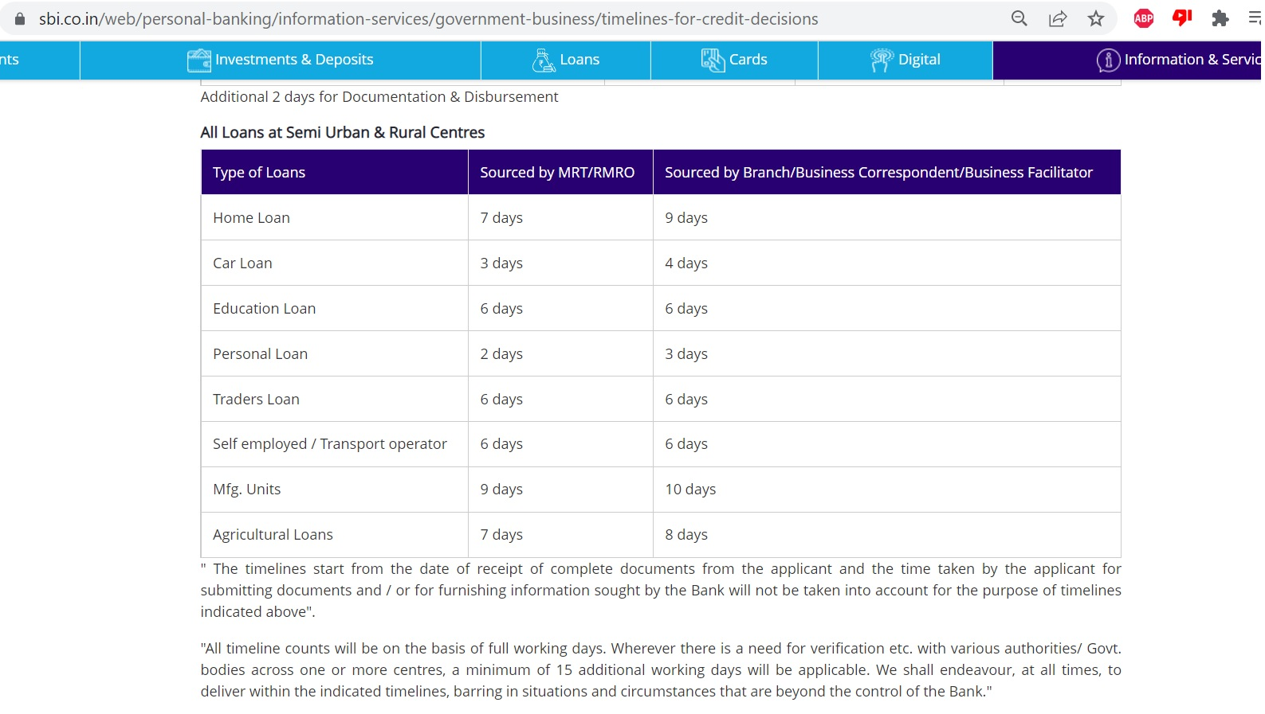
The Problem: Decision Time
Actual timelines differ vastly from the official figures ranging from weeks to months, whereas P2P lending takes only few minutes or hours.

Slide 7
The Problem: Customer migration
Lenders will lose trust on the platform if the borrowers did not repay the loan.
If a greater number of lenders face such issues, they may look for alternative option or other lending platforms.
This results in revenue loss for the platform as the platform runs on the commission received from both lenders and borrowers.

Slide 8
The Solution
We propose a classification model in SPSS using decision tree where in certain characteristics of the borrower are taken into consideration at arriving the decision to give a creditworthiness score by the platform to each customer.
Customers who registers themselves as a lender will have access to such scores so that they can make an informed decision on lending out loans.
This results in customer retention.

Slide 9
Literature Review
It was discussed in a study "Internet Based Social Lending: Past, Present and Future" by "M. Hulme and C. Wrigh" that need for online lending has emerged from lack of funding to new customers with no credit history or bad credit history.
It was also studied in a journal "bank misconduct and online lending" by "Bertsch, Christoph & Hull, Yingjie (2020)" that why banks are not serving lower end of customers as banks of have high maintenance costs and reputation to uphold.

Slide 10
Literature Review
Majority of studies revealed that years of experience has a negative effect on probability of default, which is in line with our interpretation of bivariate correlation between experience and risk of default.
Most studies conducted were based on the data obtained from USA and European nations, we focus on the data from India.

Slide 11
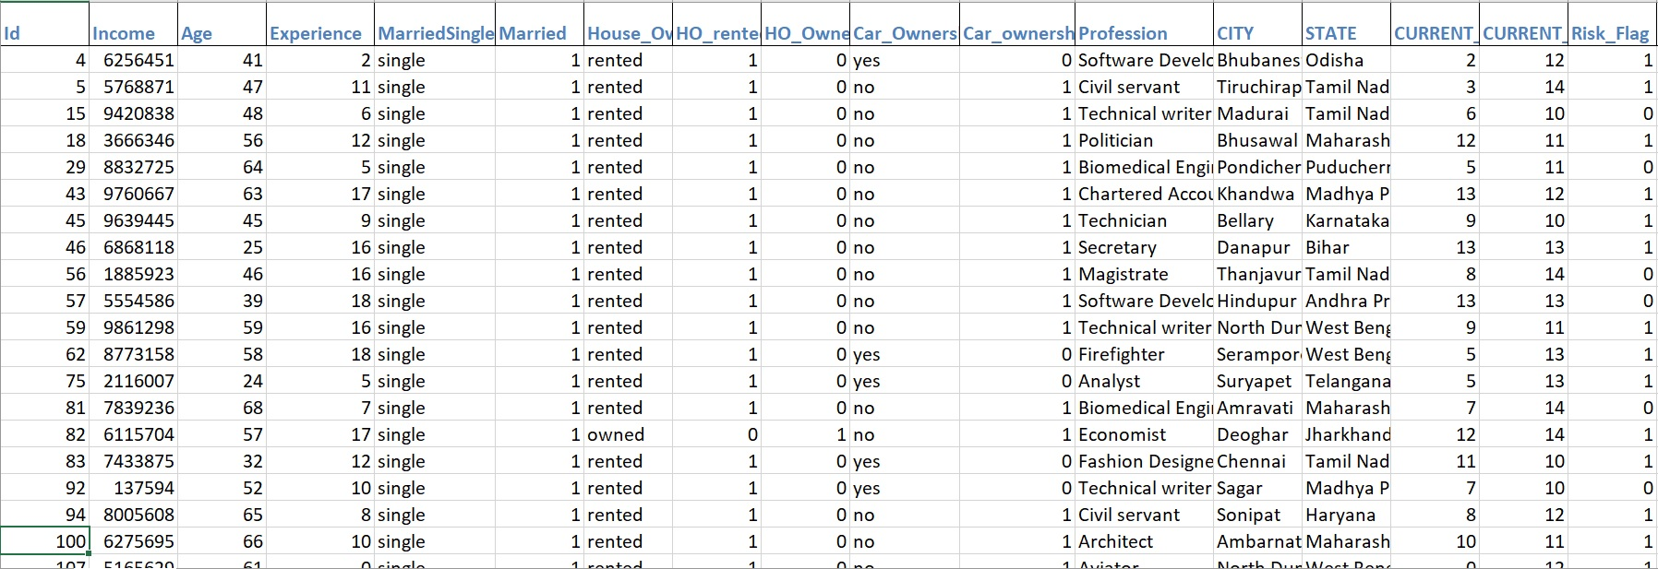
The Dataset
Source: https://www.kaggle.com/datasets/subhamjain/loan-prediction-based-on-customer-behavior

Slide 12
Variables in the Data
Experience
Income
Car Ownership
Age
House Ownership
Profession
Risk Flag

Slide 13
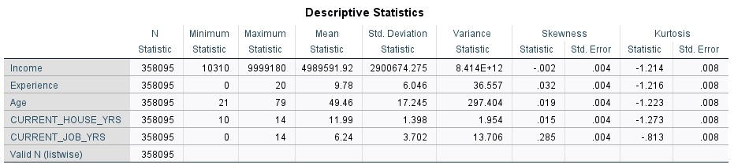
Descriptive Statistics of Continuous Variables

Slide 14
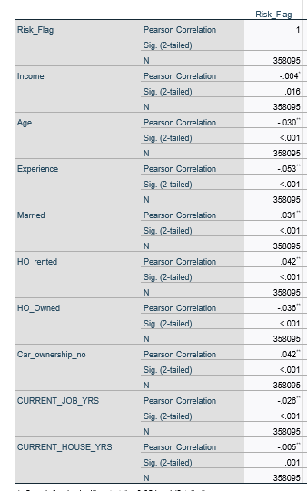
Correlation Table

Slide 15
Methodology: Data Exploration
Using Tableau ,visualized the variation in target variable to find out if there is any imbalance in the data.
We have visualized dependent variable against all the independent variables in tableau.
Upon observing the target variable(Risk_Flag) for all the independent variables, the data contains more 0s(not risky) than 1s(risky).
Using python removed random unwanted symbols and characters present in some of the columns(City, State).

Slide 16
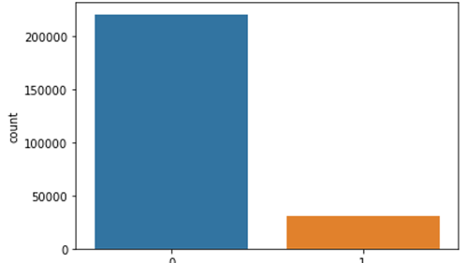
Imbalance in the Raw Data

Slide 17
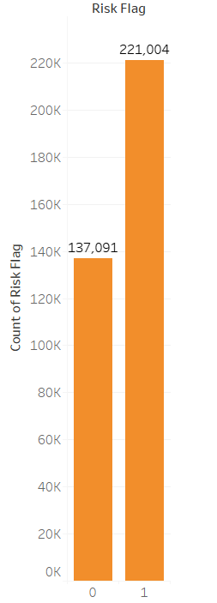
Handled imbalance after data sampling

Slide 18
Methodology: Data cleaning
The most challenging part to work on this dataset is to handle the imbalance in the data.
Using Pandas and other sampling libraries from python, we oversampled the dataset from 250,000 to 442,008.
From this oversampled dataset we picked a random subset of 358,906 records as our final dataset.
The final dataset contains 61% of 1s and 39% of 0s.

Slide 19
Methodology: Predictive analytics
Initially as mentioned in the preliminary analysis, we did perform the logistic regression, but it produced poor accuracy with a bad sensitivity.
So, using SPSS we chose another classification called Decision Trees.
While performing decision trees we chose CHAID(Chi square Automatic Interactive Decision) as our growing model and cross validation of 10 folds.
With Decision Tree classification, our accuracy, specificity and sensitivity results were improved significantly.
If we consider the predictors from best to worst for this dataset as per the tree we got, it looks like:
As we used the CHAID algorithm for the decision tree, the best predictors are chosen that have best degree of chi-square association of dependent variable with the segment of independent variable.

Slide 20
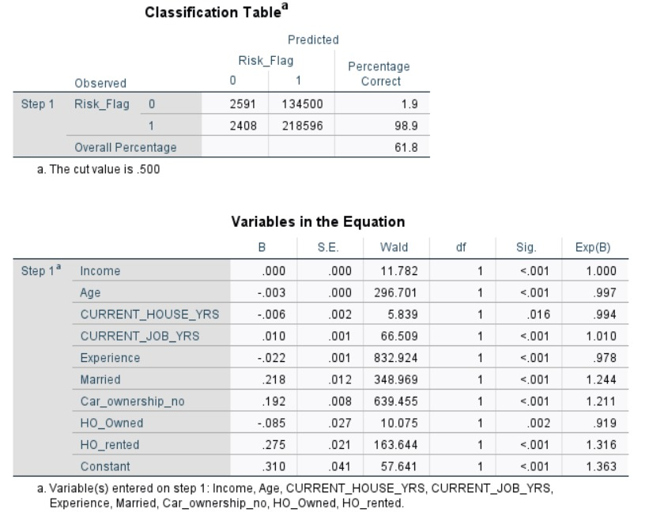
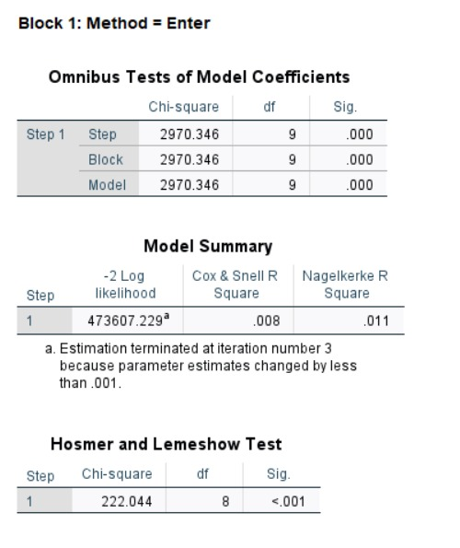
Logistic Regression Results:

Slide 21
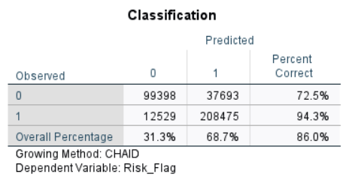
Decision Tree Results
Classification Accuracy from decision tree model:
The model’s sensitivity is really good which is the most important factor for us as we want to find out the risky candidates so that the loans will not be given to them.
For this dataset, Risk_Flag has the best association with segments of ‘Experience’ variable follow by ‘Profession’ and ‘City’ variables.

Slide 22
Upon analyzing the results, we observed that the borrowers of professions fire fighter, surveyor, consultant, technician, geologist, hardware engineer and bio medical engineer with experience less than 5 years of experience are considered risky to lend the loans.
Many more observations can be identified like above with different variables (single or combined).

Slide 23
Limitations
The assumption of any logistic model applies to this model too i.e, assuming linear relation between dependent and independent variable.
Unable to predict outliers who may default even with good credit score.
As our sample size is high , even a negligible correlation matters significantly.

Slide 24
References
Wei Li, Shuai Ding, Yi Chen, and Shanlin Yang, Heterogeneous Ensemble for Default Prediction of Peer-to-Peer Lending in China, Key Laboratory of Process Optimization and Intelligent Decision-Making, Ministry of Education, Hefei University of Technology, Hefei 2009, China.
Aslam, U., Tariq Aziz, H. I., Sohail, A., & Batcha, N. K. (2019). An empirical study on loan default prediction models. Journal of Computational and Theoretical Nanoscience, 16(8), 3483-3488.
Short-term prediction of Mortgage default using ensembled machine learning models, Jesse C.Sealand on July 20, 2018.

Slide 25
Contribution
Introduction:
Sharath – 60%
Krishna – 20%
Yogananda – 20%
Problem identification:
Yogananda – 40%
Sharath – 30%
Krishna – 30%
Data exploration and Data sampling:
Yogananda – 50%
Krishna – 25%
Sharath – 25%
Classification models:
Krishna – 40%
Sharath – 30%
Yogananda – 30%
Results interpretation:
Krishna – 35%
Yogananda – 35%
Sharath – 30%

Slide 26
Thank You!

